Slide 1
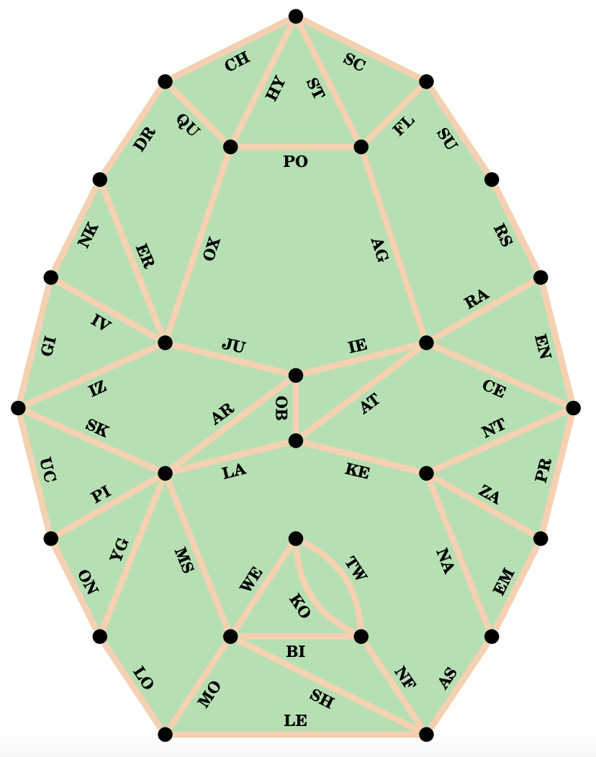

“Cactus, Cactus, Cactus, Cactus…”
In their free time, May Trix likes exploring the Cactus Garden. Every time they do so, they walk the paths to visit each landmark exactly once (and return back to where they started), but it feels like they’re taking the same paths over and over and over again…
(__) (__) (__) (__) (__)

